Slide 1

Presentation on Flight Price Prediction using ML
AUTHOR :PRINCE KUMAR
INTERNSHIP: 31

Slide 2
Problem Statement
Anyone who has booked a flight ticket knows how unexpectedly the prices vary. The cheapest available ticket on a given flight gets more & less expensive over time. This usually happens as an attempt to maximize revenue based on –
1. Time of purchase patterns (making sure last-minute purchases are expensive)
2. Keeping the flight as full as they want it (raising prices on a flight which is filling up in order to reduce sales and hold back inventory for those expensive last-minute expensive purchases)
So, you have to work on a project where you collect data of flight fares with other features and work to make a model to predict fares of flights.

Slide 3
LITERATURE review

Slide 4
Flight Price Prediction
Customers are seeking to get the lowest price for their ticket, while airline companies are trying to keep their overall revenue as high as possible and maximize their profit.
India is the third-biggest avionics showcase in 2020 and the biggest by 2030.
From the customer point of view, determining the minimum price or the best time to buy a ticket is the key issue. The conception of ‘‘tickets bought in advance are cheaper” is no longer working (William Groves and Maria Gini, 2013)

Slide 5
Flight Price Prediction
According to Y. Chen et al. (2015) , predicting the actual ticket price is a more difficult task than predicting an optimal ticket purchase time due to various reasons.
The higher the level of competition, the weaker of the market power of an airline, & then the less likely the chance of the airline fare increases.
Tziridis et al. In his comparison, Bagging Regression Tree is identified as the best model, which is robust and not affected by using different input feature sets.
The presence of LCC in a market has had a substantial impact on the total passenger volume and the air ticket price.

Slide 6
Flight Price Prediction
It is a common practice for airlines to pass the cost of aviation fuel to the customer by adjusting the fare to compensate for the fluctuation of crude oil price.
In Another finding , When the flight is at a difference of 2-3 days’ time the ticket price starts increasing again.
Short distance flights are more elastic (more price sensitive) than long distance flights
Business class flights are more inelastic as compared to leisure class as business customers have less flexibility to change or cancel their travel date.

Slide 7
Web Scraping Strategy employed
Selenium will be used for web scraping data from www.yatra.com
Flights on route of New Delhi to Mumbai in duration of 23 Jan 2022 to 4 Feb 2022.
Data is scrap in three categories:
Economy class flight price extraction
Business class flight price extraction
Premium Economy class price extraction
Selecting features to be scrap from website.
In next part web scraping code executed for above mention details. Exporting final data in Excel file.

Slide 8
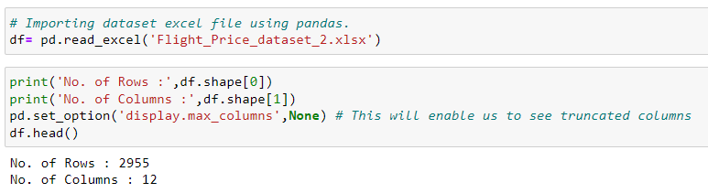
Dataset Information
Dataset contain flight detail of around 2955 Flights on route New Delhi to Mumbai.
Dataset has 12 features like Airlines, flight, Aero plane etc.

Slide 9
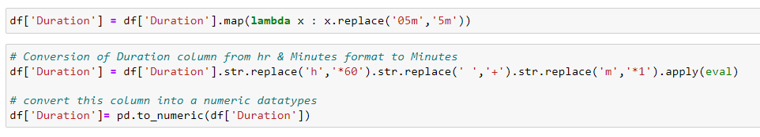

Data Preprocessing
Conversion of Duration column from hr & Minutes format into Minutes .
New column for ‘Day’ & ‘Date’ is extracted from Date column.

Slide 10
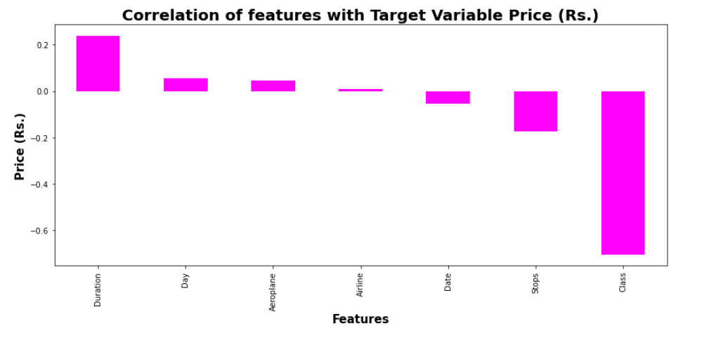
Correlation with Target Variable
We can see that class feature is correlated for more than -0.6 with target variable Price.
Remaining feature are poorly correlated with target variable price.

Slide 11
Exploratory Data Analysis

Slide 12
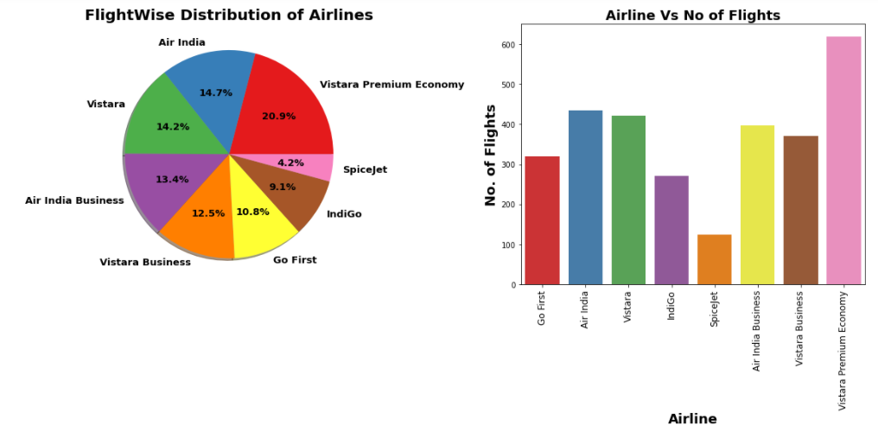
Flight-wise Distribution of Airlines
We can see maximum number of flights run by Vistara Premium Economy while minimum Flights run by SpiceJet.
Around 25% of flights of Business Class.

Slide 13
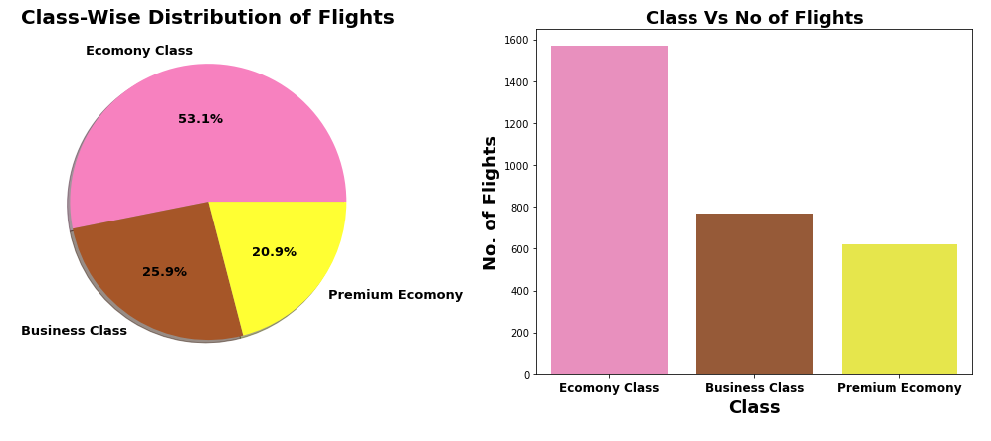
Class-wise Distribution of Flights
53.1% flights are of Economy class, as they are low cost of flight & most of people prefer it.
There are more business class flights than Premium Economy flights. It strange because Business class is costlier than Premium Economy class.

Slide 14
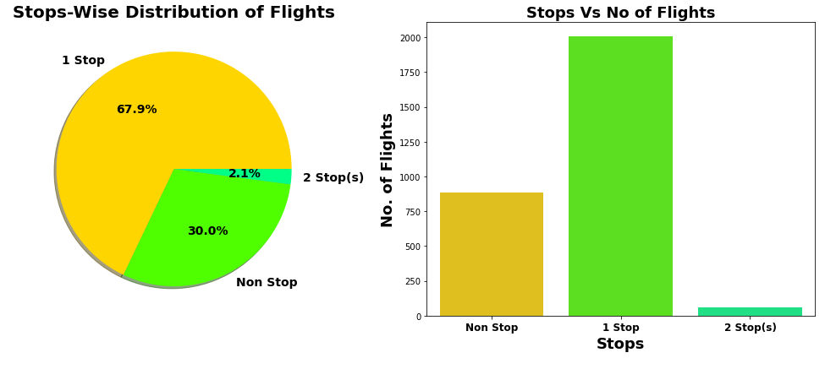
Stop-wise Distribution of Flights
67.9% flights take single stop in their way from New Delhi to Mumbai. It is also possible that these flights may have high flight duration compare to Non-stop Flight.
30% of flights do not have any stop in their route.

Slide 15
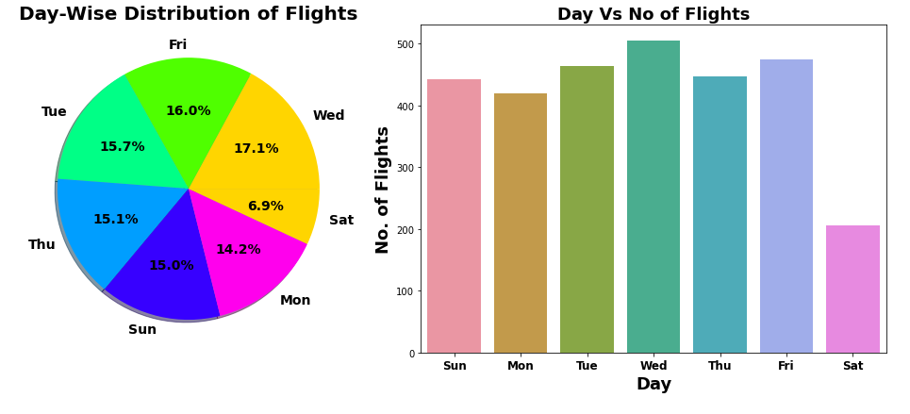
Day-wise Distribution of Flights
On Wednesday Maximum flights run while on Saturday minimum flights run.

Slide 16
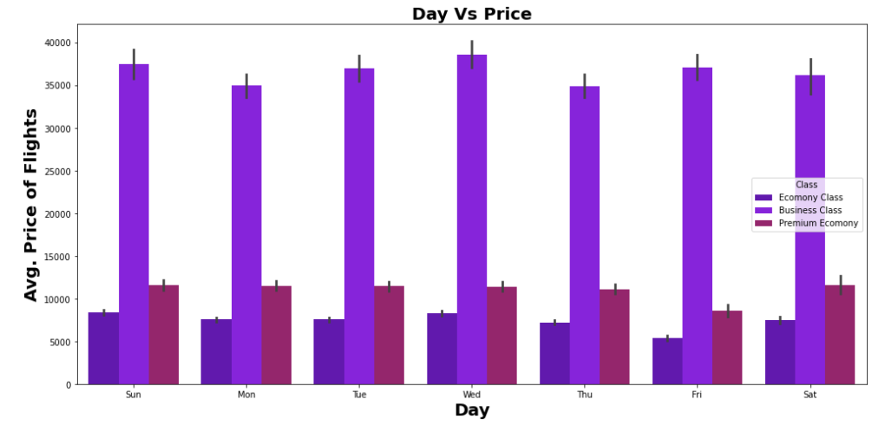
Day Vs Avg. Flight Price
Maximum Avg. Fare for Business Flights is on Wednesday while minimum Avg. Fare for Business flights on Thursday.
For Economy Flights & Premium Economy Flights: Minimum Avg. Fare on Friday.
For Economy Flights & Premium Economy Flights: Maximum Avg. Fare on Monday.

Slide 17
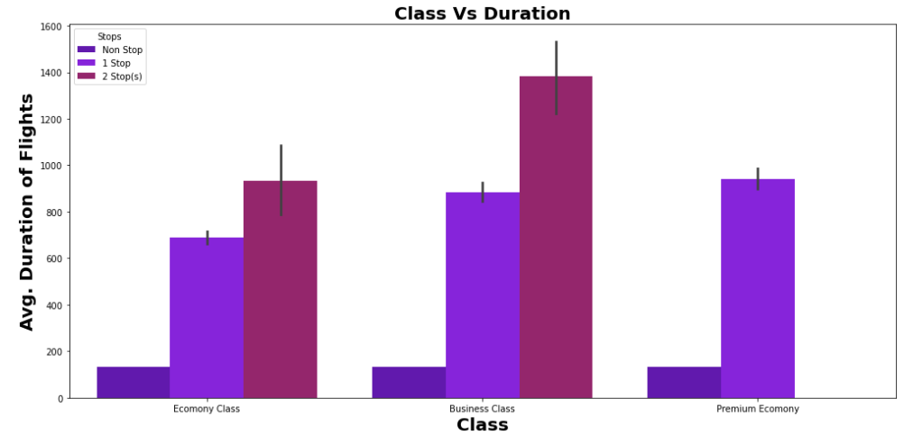
Class Vs Avg. Duration of Flights
As Number of Stops increase the duration of flights increases.
As per Class of flight Maximum Avg. Duration of flight is for Business class.

Slide 18
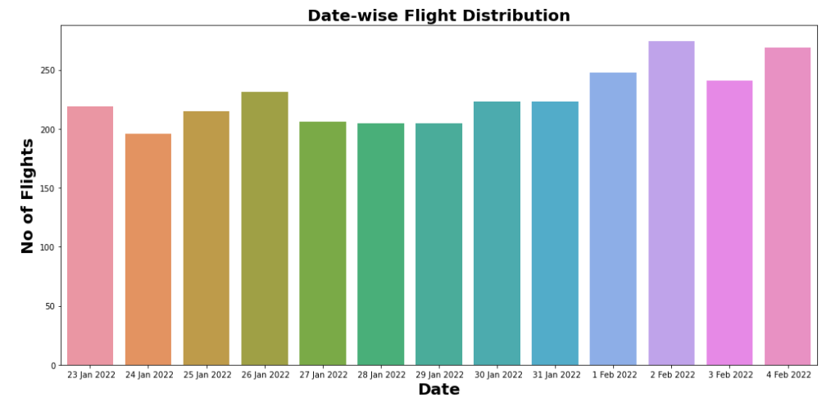
Date-wise Flight Distribution
We can see those Maximum flights schedule on 2 Feb 2022 & Minimum flights schedule on 24 Jan 2022.

Slide 19
Machine learning MODEL BUILDING

Slide 20
Machine Learning Model Building
This problem can be solve using regression-based machine learning algorithm.
Methodology to Build Machine Learning Model:
Encoding Categorical data into Numerical data
Scaling data using Standard Scalar
Splitting data in training & test data using train_test_split from model_selection
Implementing various Regression Based Algorithm to build ML Model
Conducting 5 fold Cross validation
Hyper Parameter tuning of best Model
Saving Final Tuned Model using Joblib

Slide 21
REGRESSION ALGORITHMS IMPLEMENTATION
The different regression algorithm used in this project to build ML model are as below:
Linear Regression
Random Forest Regressor
Decision Tree Regressor
XGB Regressor
Extra Tree Regressor

Slide 22
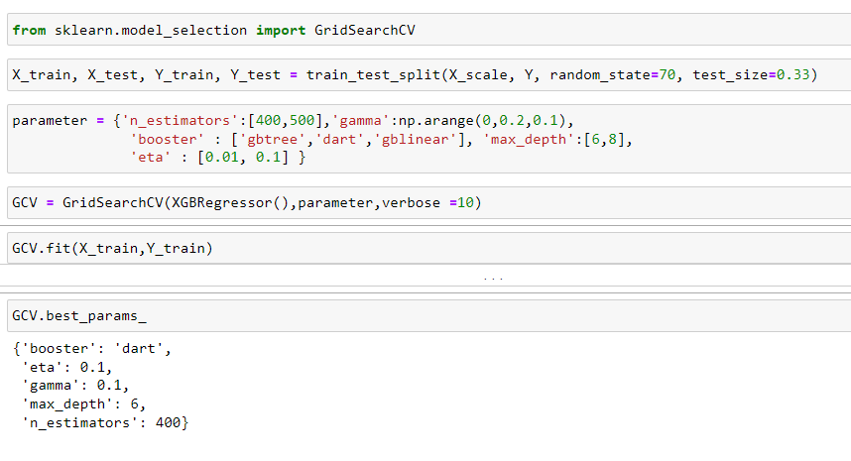
Hyper Parameter Tuning of Best Model
XGB Regressor gives maximum R2 score of 99.013 and maximum cross validation score.
Among all model we will select XGB Regressor as final model and hyper parameter tuning perform over this model to enhance its R2 Score.

Slide 23
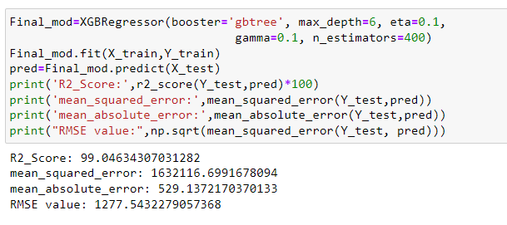
Final ML Hyper Parameter Tuned Model
There is Slight increase in R2-Score to 99.046% after hyper parameter tuning from previous R2-Score of 99.013%.

Slide 24
Final Evaluation Matrix
Algorithm | R2 Score | CV Score
Random Forest Regressor | 98.87 | 0.7976
XGB Regressor | 99.013 | 0.7582
Linear Regression | 73.32 | -16.392
Decision Tree Regressor | 98.50 | 0.6535
Extra Tree Regressor | 98.43 | 0.6631
XGB Hyper Parameter Tuned Final Model | 99.046 | 0.8283

Slide 25
Limitations & Future Scope
In this study we focus on flights on route of New Delhi to Mumbai, more route can incorporate in this project to extend it beyond present investigation.
This investigation focus on short timeframe (14 days prior flights take off) which can be extended variation over larger period.
Time series analysis can be performed over this model.

Slide 26
THANK YOU VERY MUCH !!!

